Slide 1
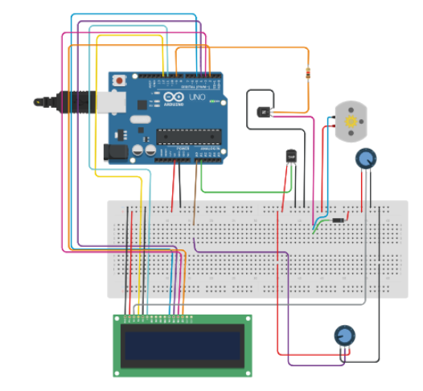
A Smart Room Monitoring System
Temperature & Humidity Monitoring with Automatic Fan Control
Using Arduino Uno

Slide 2
Group Members
 | Name | Registration Number
1 | Twesigye Ronald Karakire | 244-576
2 | Kunihira Joshua | 244-878
3 | Ssemuyobe Charles Disan | 274-711
4 | Ekyatuhaire Josephine | 255-181
5 | Okee Samuel Jude | 241-819
6 | Matsiko Vian | 268-850
7 | Faith Auma Brenda | 259-453

Slide 3
Introduction
The Smart Room Temperature and Humidity Monitoring with Automatic Fan Control System continuously measures room temperature and humidity
Automatically controls the fan based on predefined temperature and humidity thresholds.
This ensures comfort, energy efficiency, and convenience without requiring constant human intervention.

Slide 4
Problem Statement
Room temperature and humidity are not properly monitored and controlled:
People forget to turn ON fans
Fans left ON unnecessarily
Energy wastage
High humidity causes damage and discomfort

Slide 5
Proposed Solution
A System that monitors temperature & humidity.
Automatically turns fan ON/OFF based on conditions.
Displays real-time data.

Slide 6
Objectives
Monitor temperature & humidity
Automate fan control
Reduce energy consumption
Improve comfort for individuals in the room

Slide 7
Target Users
Schools
Offices
Hostels
Churches
Smart home users
Energy-conscious people
Elderly individuals

Slide 8
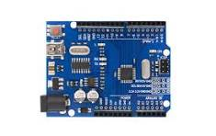
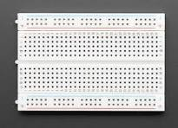


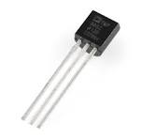
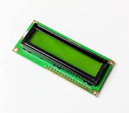
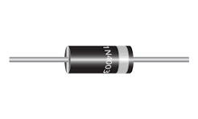
Components Used
Arduino Uno
Temperature & Humidity Sensor
DC Motor
2 Potentiometers
NPN Transistor
LCD 16 X 2

Slide 9
How the System Works
Sensor reads data
Arduino processes the input data
DC Motor activates the Fan and regulates speed of the fan
LCD displays values
Fan turns ON/OFF automatically
Prototype accessed via [Github link]

Slide 10
Advantages
Energy efficient
Automated and Time Saving
Low cost
Easy to build
Improves comfort
Scalable for smart home systems

Slide 11
Future Improvements
Mobile app control
IoT integration
Data storage
Alerts/notifications

Slide 12
Conclusion
This project demonstrates how simple embedded systems using Arduino can solve real-life problems. It enhances comfort, reduces energy waste, and provides a foundation for smart home automation
The system provides an efficient and automated way to maintain room comfort and reduce energy waste.

